Slide 1

Synthetic Biology Open Language Applications
Presenter: Dr Göksel Mısırlı
School of Computing and Mathematics
SBOL Editors: Hasan Baig (Habib University), Vishwesh Kulkarni (University of Warwick), Curtis Madsen (Boston University), James McLaughlin (Newcastle University), Zach Palchick (Zymergen)
SBOL Chair: Chris Myers (University of Utah)
SBOL Workshop
July 8, 2019
Slides were provided by Jacob Beal, Chris Myers and Anil Wipat
These slides were adapted and new slides were added by Göksel Mısırlı

Slide 2
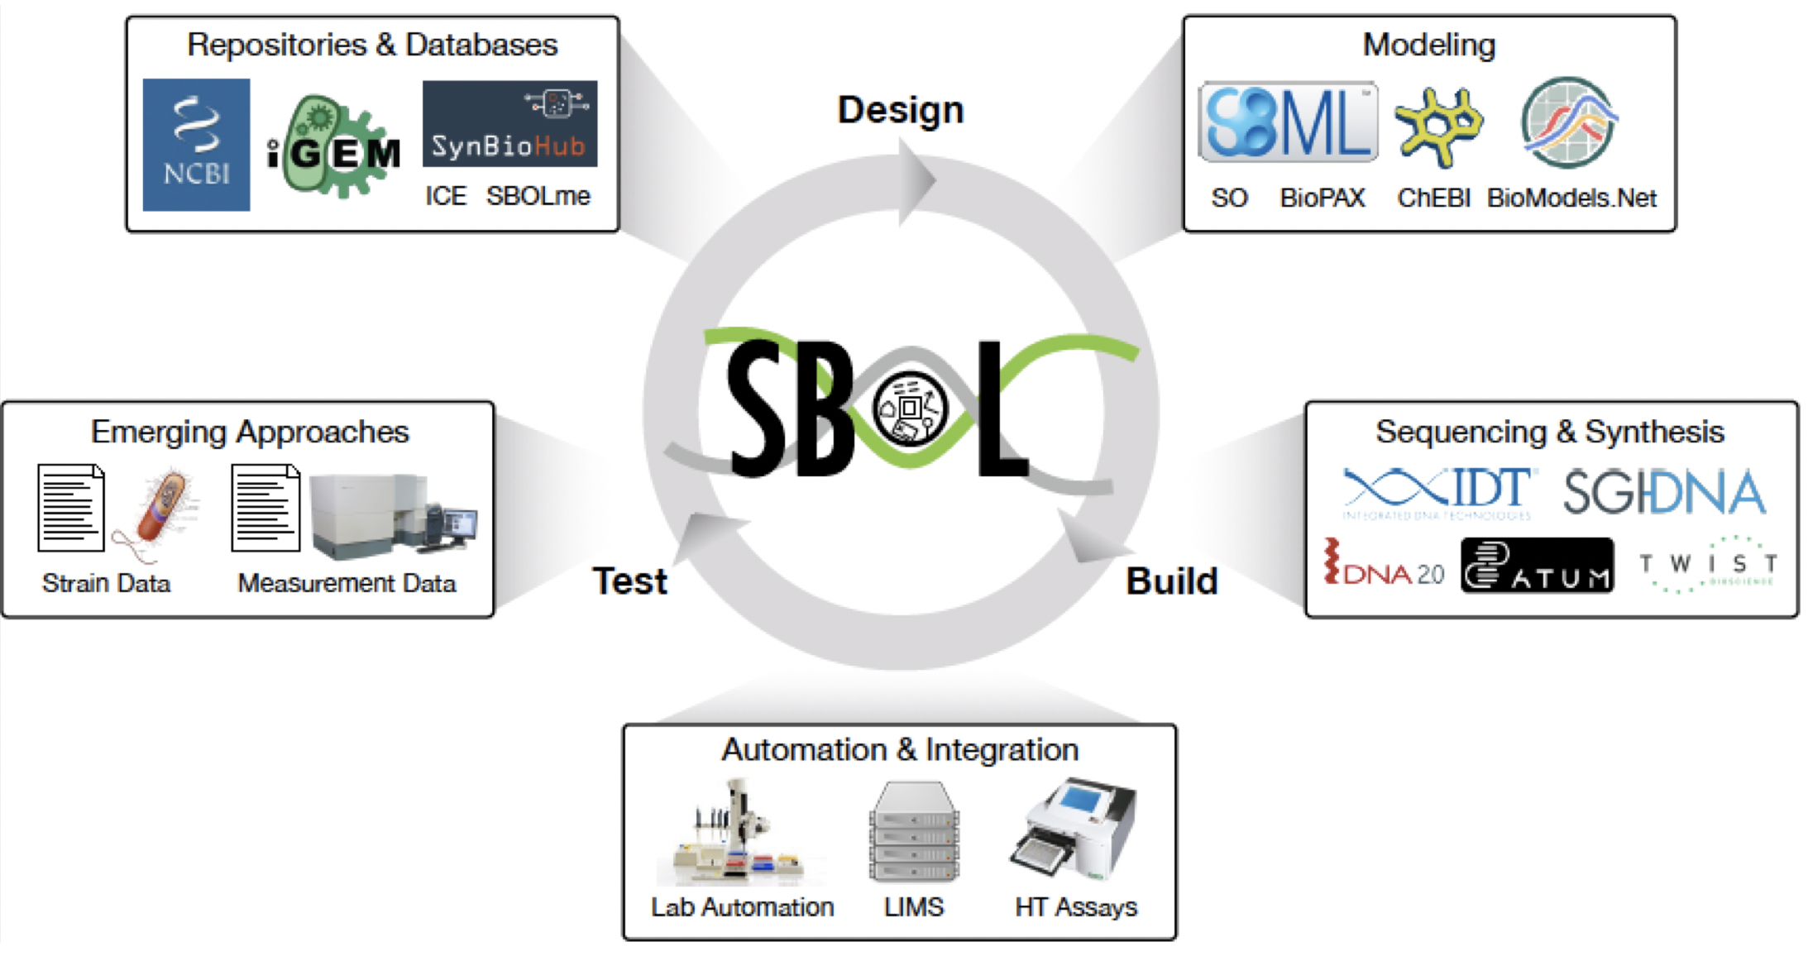
Collaborating across different stages of (automation-assisted) synbio workflows
Myers et al., 2017
Unambiguous exchange of information
Reuse of information and existing tools
Extendible data model to incorporate application specific data
Integrating with existing technologies to store, query and visualise data

Slide 3
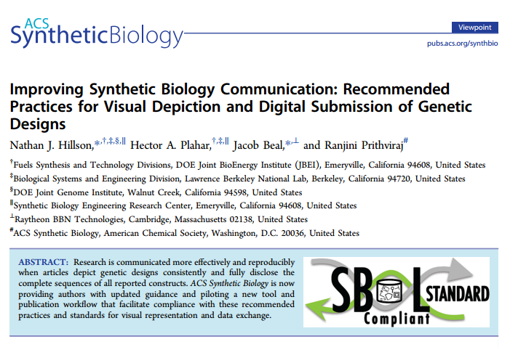
ACS Synthetic Biology has officially adopted SBOL as publication standard
SBOL Visual is the recommended graphical notation for depicting genetic constructs
SBOL 2.0 Data Model is the preferred format for nucleic acid sequences
Manuscript submission, review, and production process is linked to SBOL-enabled repositories
Joint BioEnergy Institute (JBEI) has set up the initial repository

Slide 4




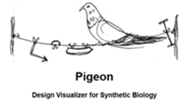

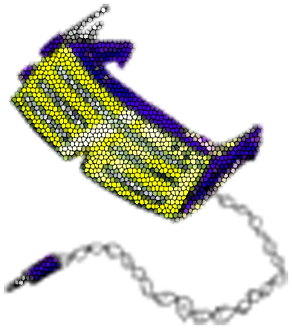




Applications
iBioSim
Gene Designer
Shortbol
poolDesigner
DeviceEditor
SBOLDesigner

Slide 5
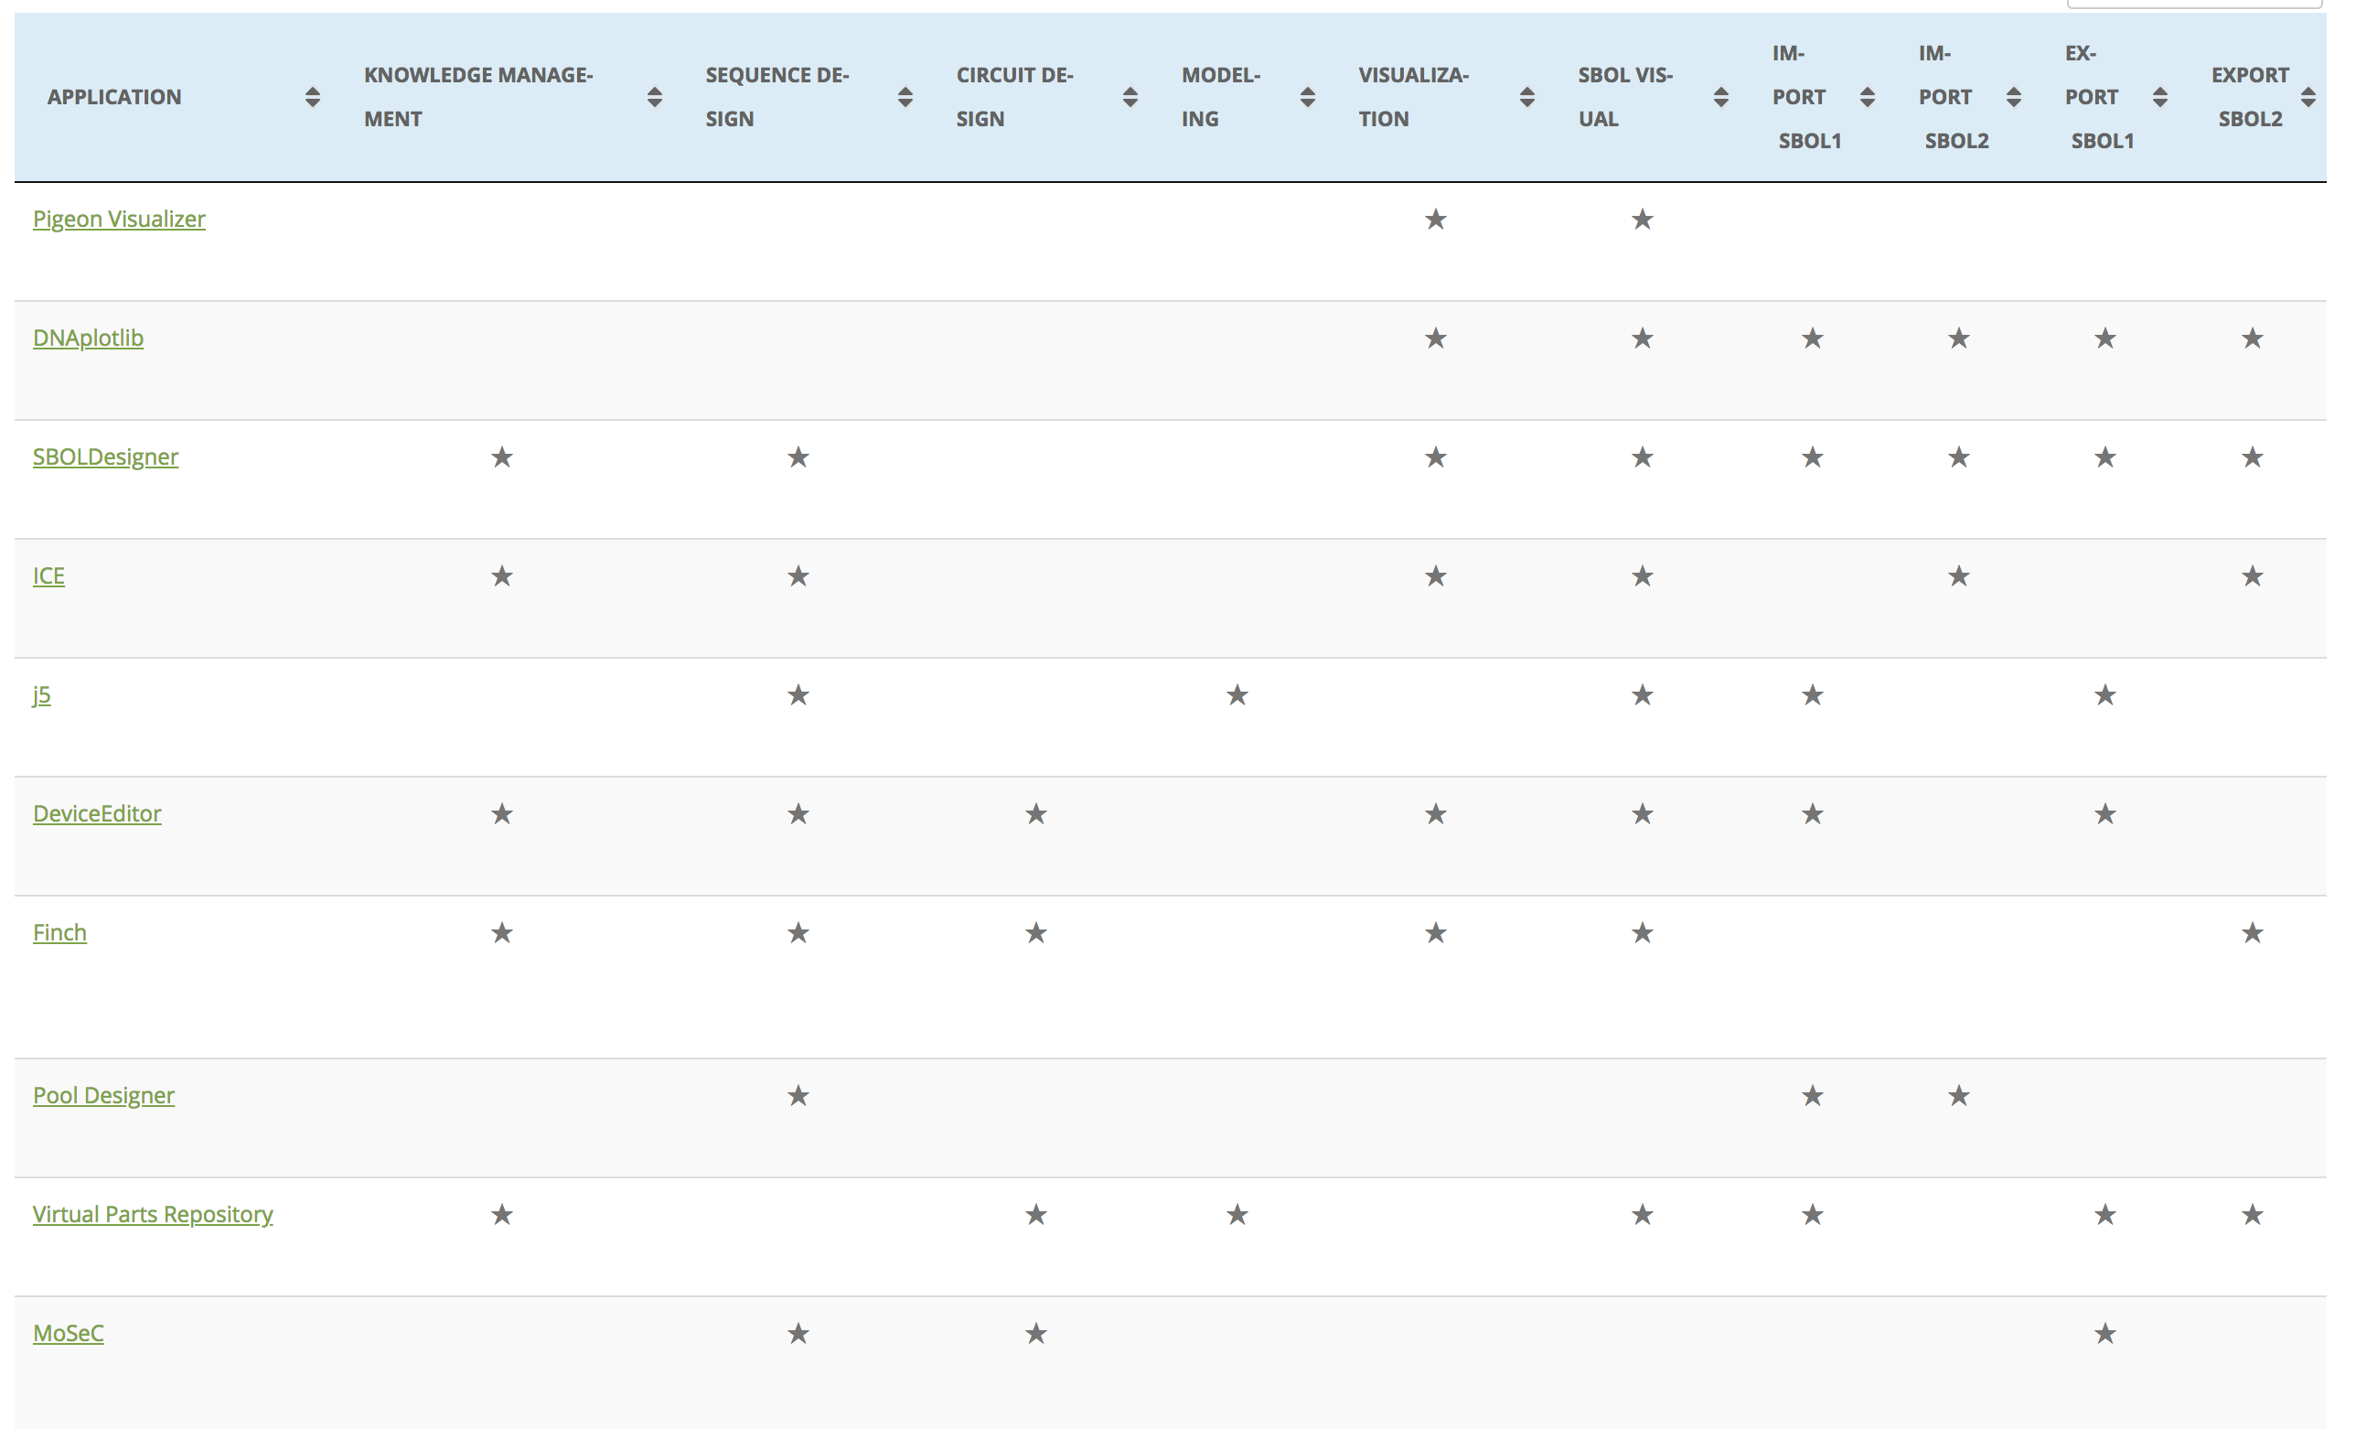
Applications - continued
http://sbolstandard.org/applications

Slide 6
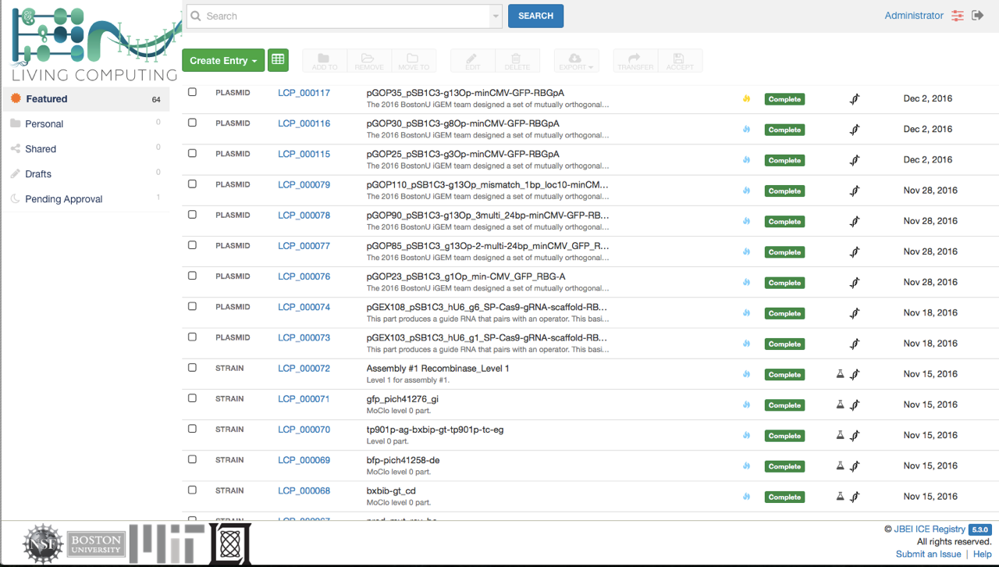
Data Repositories: Inventory of Composable Elements (ICE)
Ham et al., Nucleic Acid Research (2012)

Slide 7
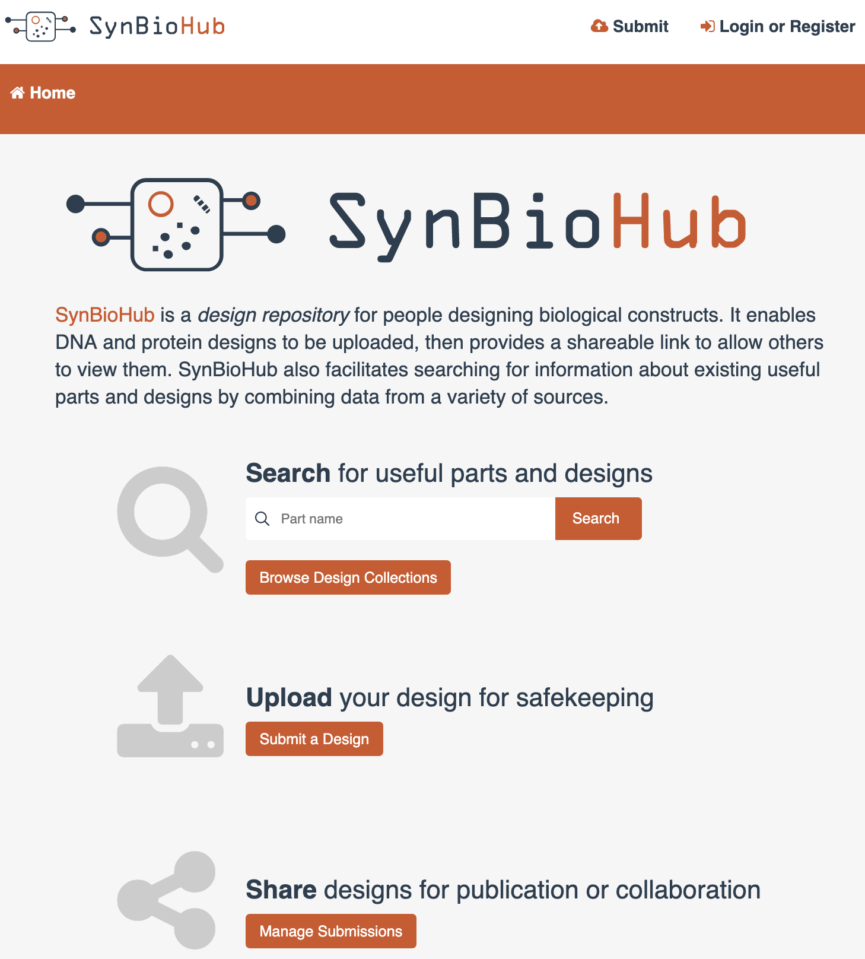
Data Repositories: SynBioHub
Supports storing and retrieving native SBOL and other related data
Unified syntax and semantics via SBOL
Data can be federated across multiple instances
A web of registries
Promotes data integration
McLaughlin et al., ACS Synthetic Biology (2018)

Slide 8
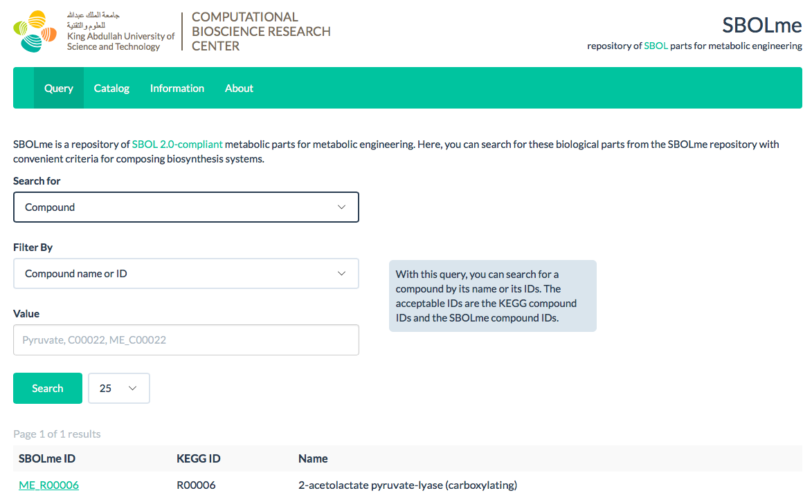
Data Repositories: SBOLme
Kuwahara et al., ACS Synthetic Biology (2017)
28,437 chemical compounds, 6,883 enzyme classes, 9,909 metabolic reactions, and 3,173,238 proteins from 3,908 organisms

Slide 9
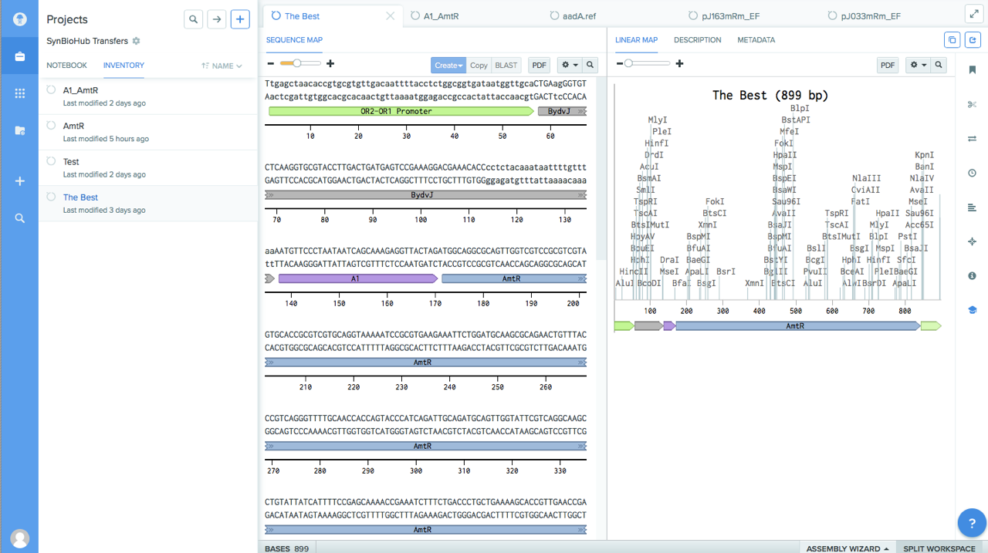
Sequence Editor: Benchling

Slide 10
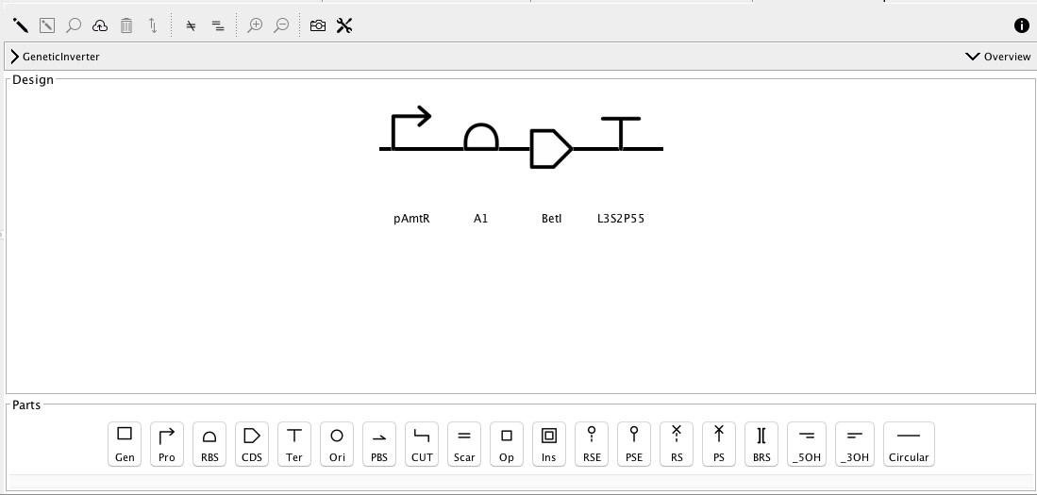
Sequence Editor: SBOLDesigner
Zhang et al., ACS Synthetic Biology (2017)
Other sequence editors that support SBOL: DeviceEditor, J5, VectorEditor (JBEI), DNAPlotLib (MIT/UW/Bristol), Eugene (Boston), GenoCAD (VBI), BOOST (JGI), etc.

Slide 11
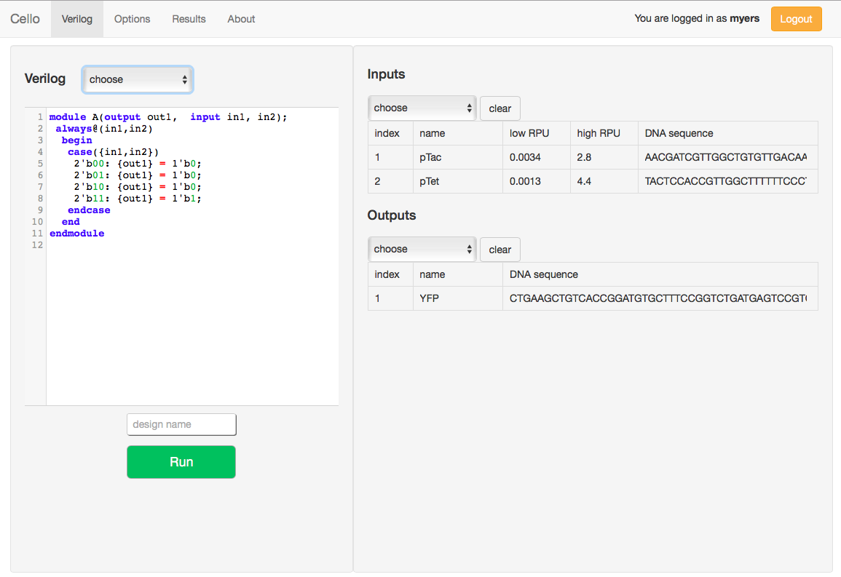
Circuit Design & Modelling: Cello
Nielsen et al., Science (2016)
Compiles combinational designs described in Verilog into genetic circuits
Uses a gate library of 2-input NOR gates and inverters

Slide 12
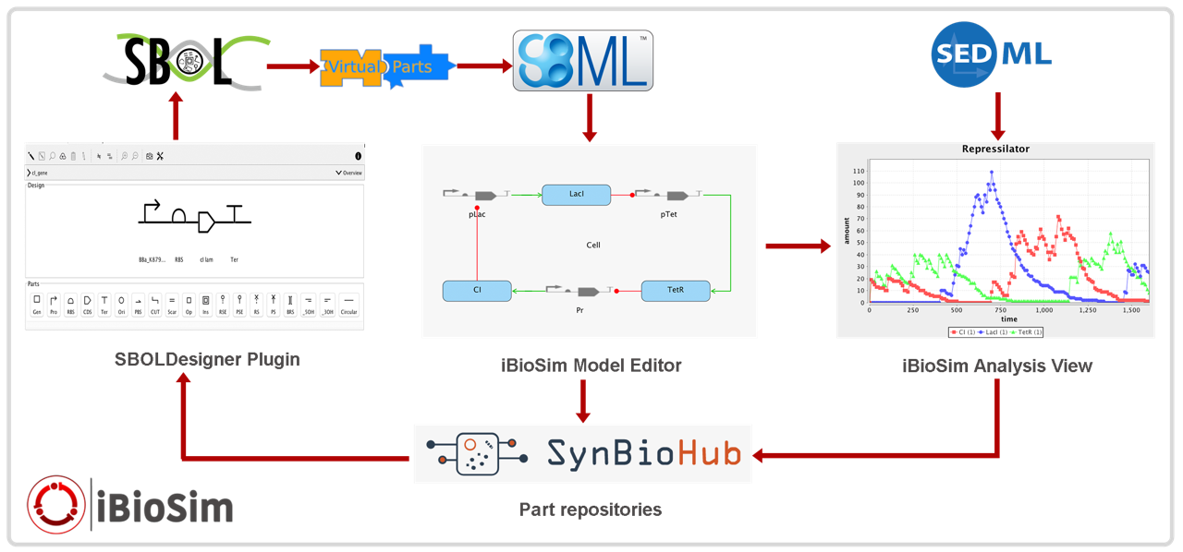
Circuit Design & Modelling: iBioSim
Madsen et al., IEEE Design & Test (2012)
Supports modeling, analysis, and design of genetic circuits
Modelling uses SBML, analysis uses SED-ML, and design uses SBOL
Includes SBOLDesigner as plugin providing a connection to SynBioHub
Provides converters between SBML and SBOL

Slide 13






Circuit Design & Modelling: Virtual Parts Repository
A repository of modular and composable models of biological parts and interactions
Provides a modelling abstraction for genetic circuit designs specified in SBOL files
pLacI
RBS
tf
terminator
Web repository
TF
Web service (REST)
Model (SBML)
Data (SBOL)
pLacI
RBS
tf
terminator
Gene expression
Time
Misirli et al., IWBDA (2019), Misirli et al., JETC (2014)

Slide 14
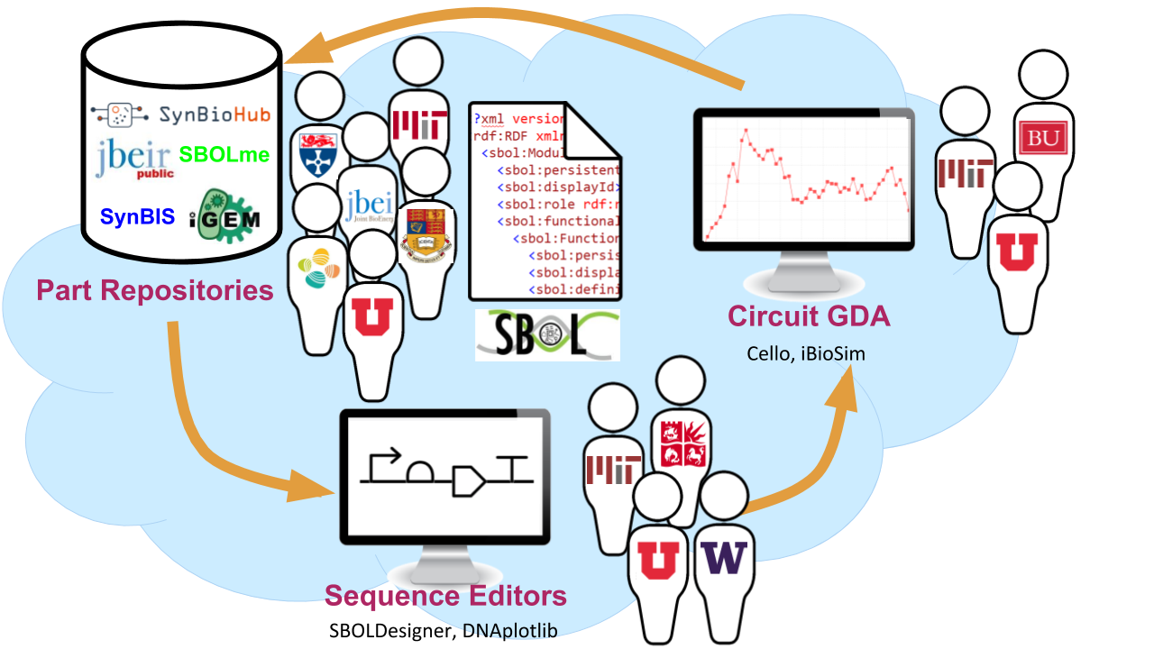

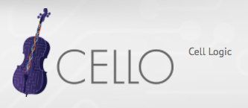
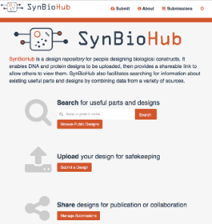

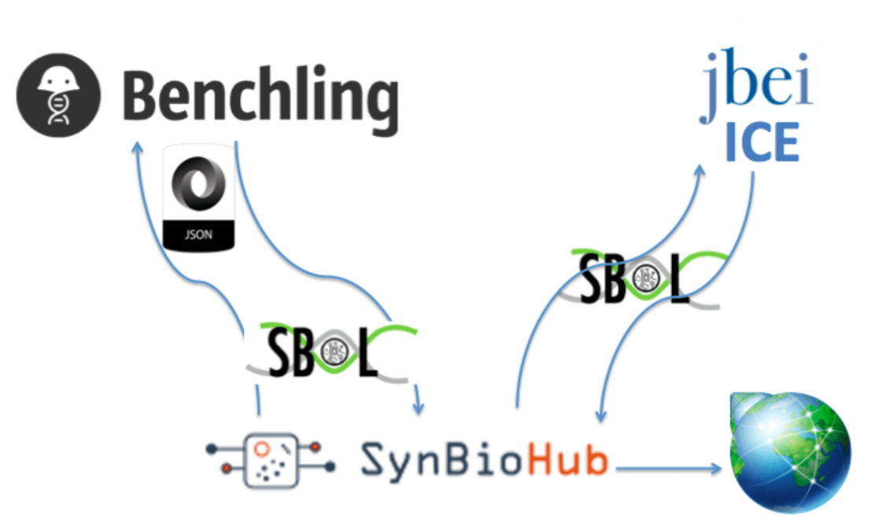


Workflows: SynBioHub as a central hub for synbio data management and workflows
SBOLDesigner
SynBioHub

Slide 15
Workflows: Automated generation of models of genetic designs
Misirli & Nguyen et al., 2018
ACS Synthetic Biology

Slide 16
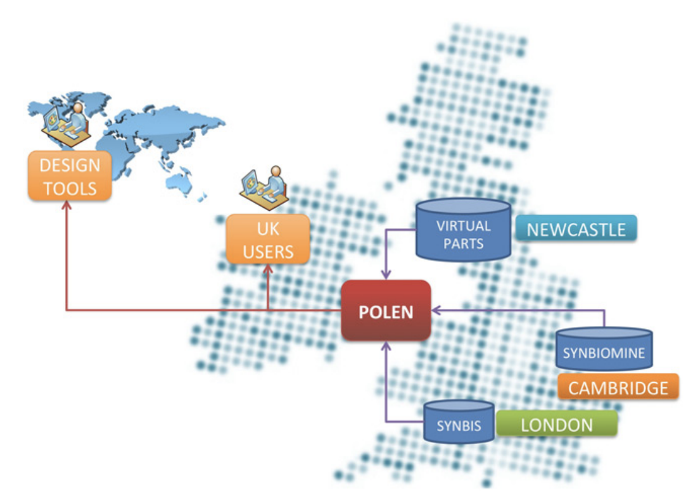
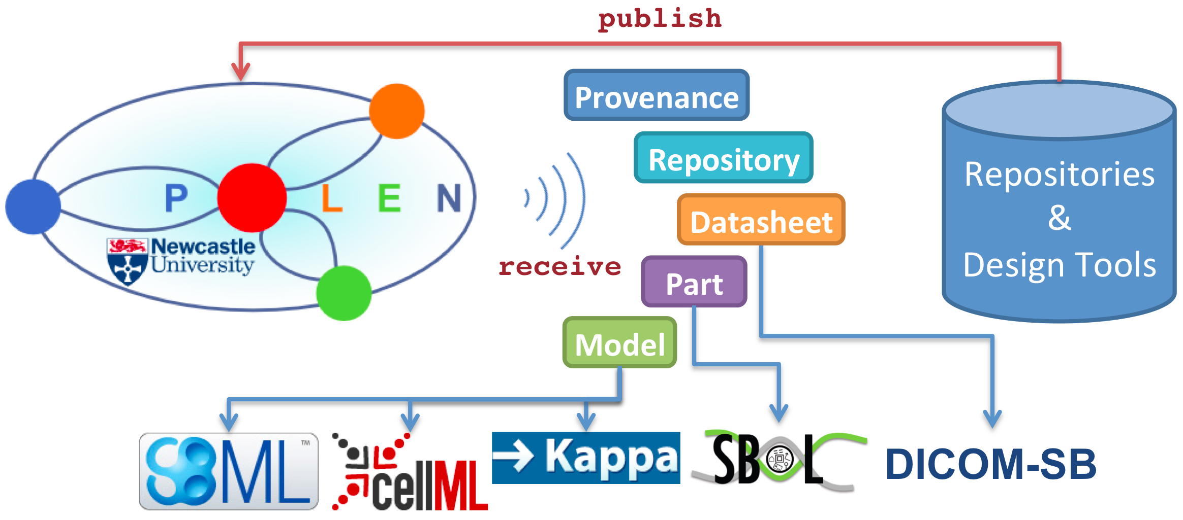
Workflows: POLEN - PrOtocol for Linking External Nodes
Light-weight, asynchronous, Cloud-based messaging system
Messages can be published/received for a particular topic
Messages include URIs that point to actual resources in standard formats
Misirli et al., 2017
IET Engineering Biology

Slide 17
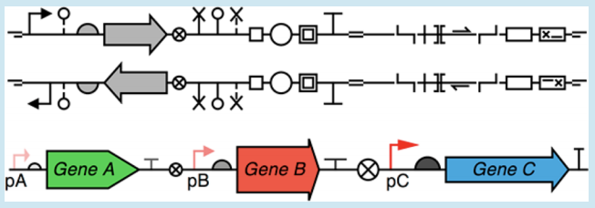
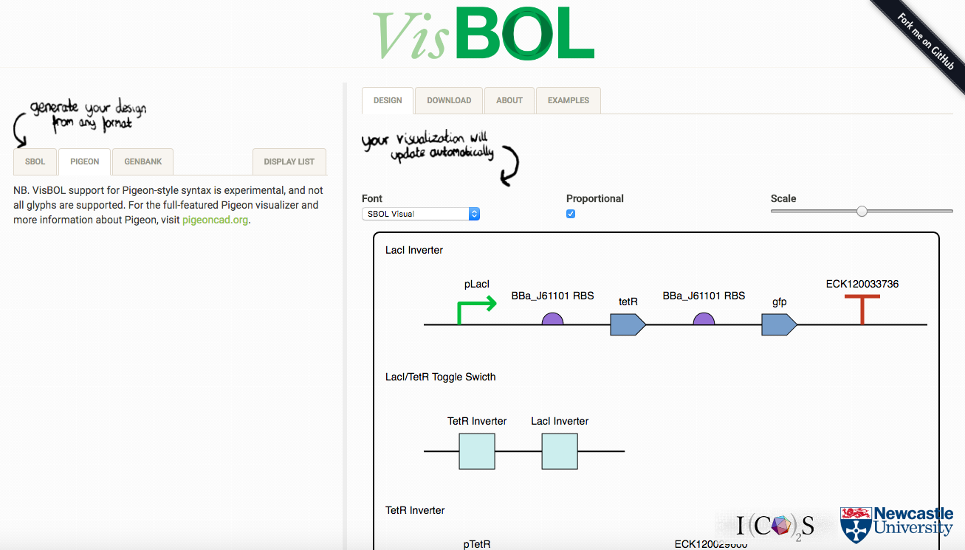
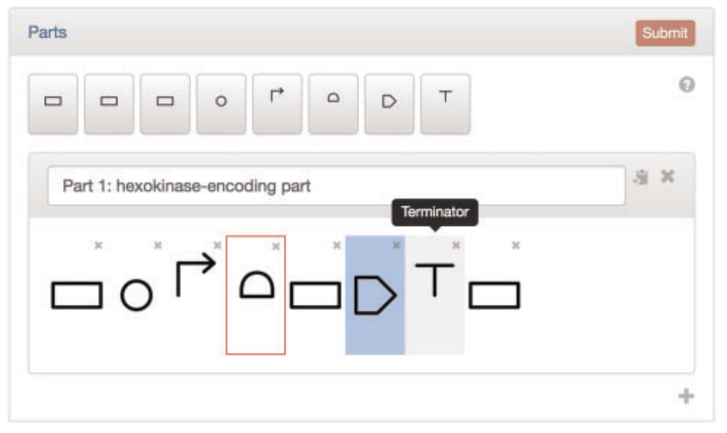
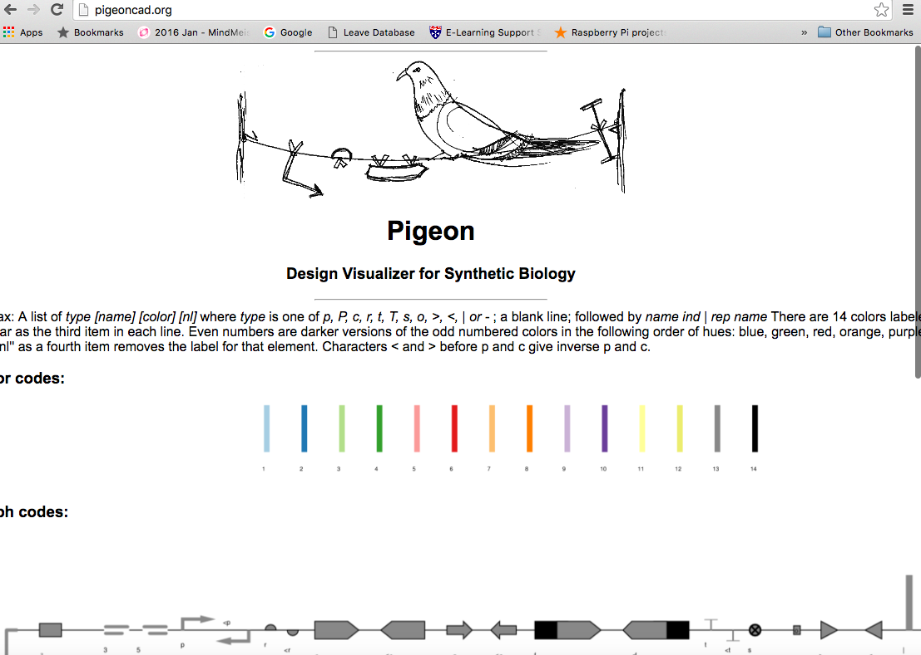
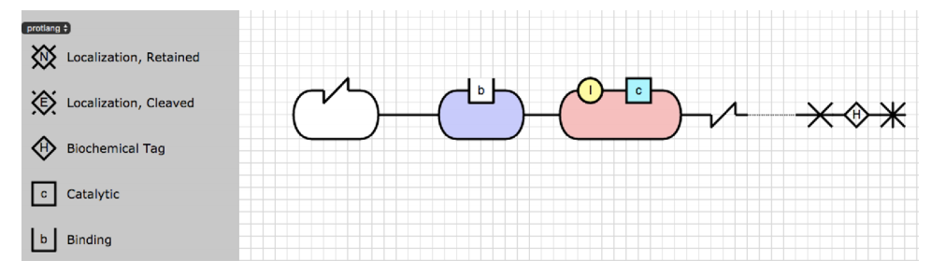
Visualisation examples
DNAplotlib
PartsGenie
ProteinDesigner

Slide 18
Open source libraries
Software libraries which import and export SBOL files are freely available at the Synthetic Biology Data Exchange on GitHub under the Apache 2.0 license.
Library | Programming Language
libSBOLj | Java
sboljs | JavaScript
libSBOL | C++
pySBOL | Python
semanticSBOL | OWL
SBOL-Validator | Online validation
Developer support
Online documentation
Getting started tutorials
Sample projects
Code examples
http://sbolstandard.org/software/libsbol
https://github.com/SynBioDex/

Slide 19



Acknowledgments
SBOL Developers
sbol-dev@googlegroups.com
SBOL Editors
editors@sbolstandard.org
SBOL Libraries
http://sbolstandard.org/software/libsbol
Synthetic Biology Data Exchange Group
https://github.com/SynBioDex/
http://sbolstandard.org

